Slide 1
Data Science Lab - Assessment
Airbnb listing price model

Slide 2



Introduction

Slide 3



Introduction

Slide 4
Assessment details
“Predict the price of a new Airbnb listing”
22,552 records
96 columns
Approach
Step 1 – Online research
Step 4 – Variable elimination
Step 2 – Exploratory data analysis
Step 5 – Regression Modeling
Step 3 – Data processing & enhancing
Step 6 – Model assessment

Slide 5

Step 1 – Online research
Plenty of information online
Linear Regression
XGBoost
RidgeRegression
Try a naive model as reference
Complexity later

Slide 6
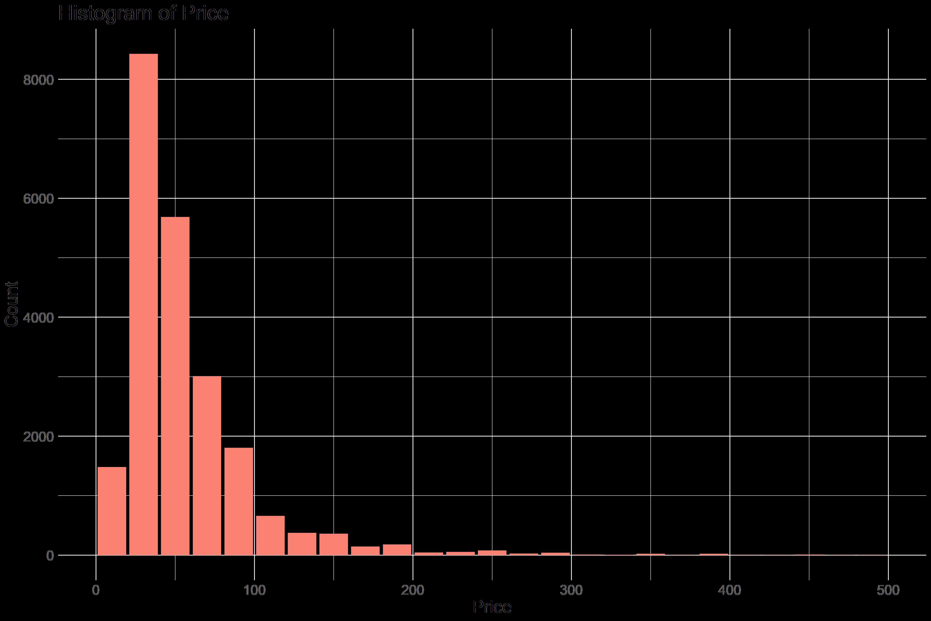
Step 2 – Exploratory data analysis
Exploratory data analysis consisted of:
Checking how many fields
Checking values and formats
Checking the distribution of some variables
And led to the following conclusions:
All listings are in Berlin and surroundings
Price is not normally distributed
Data cleaning will be needed
Data reformatting will be needed
“$60.31” 60.31
Latitude, Longitude Distance to Center

Slide 7
Step 3 – Data processing and enhancing
There are many reasons to exclude a variable:
Too many missing values
One unique value
No overlap in categorical values
This step excluded 39 variables
Column | Keep? | Reason
Price | Y | Dependent variable
... | ... | ...
Square_feet | N | 98% NAs
Has_availability | N | 1 unique value
... | ... | ...
Id | N | No overlap in values

Slide 8
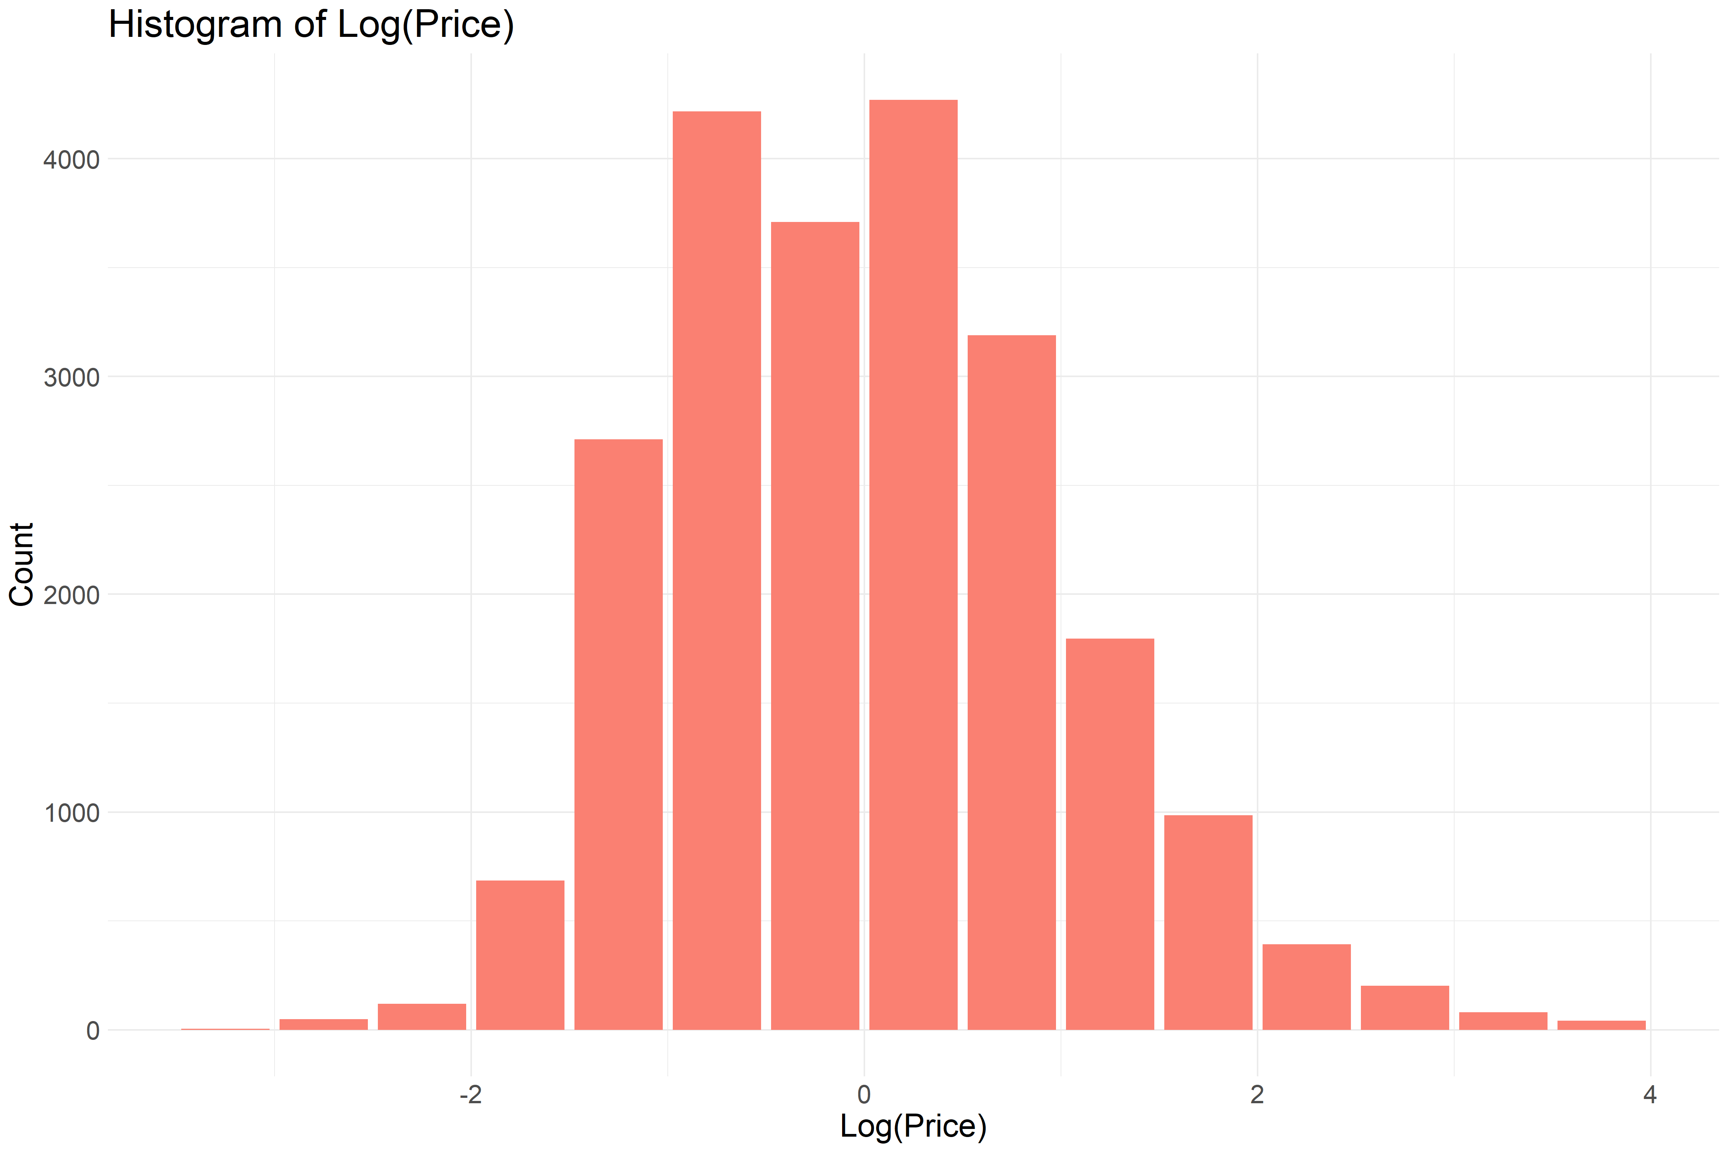
Step 3 – Data processing and enhancing
As part of the data enhancing
The dependent variable was changed
All numerical variables were standardized
Categorical fields were analyzed and refined
This created 16 additional variables

Slide 9
Step 4 – Variable elimination
Variable elimination was conducted based on correlation
At the end, this left 23 variables for the simple regression and 36 for the complex version
No
High correlation with better variable?
No
Low correlation with price?
Variable
Candidate
Yes
Yes
Eliminated
Eliminated

Slide 10

Step 5 – Regression modeling
We start out with the MLR model for the naive model
The algorithm tries to minimize the error of each prediction and uses the R² metric as a performance measure
The flow of the regression calibration is as follows:
Start out with all variables and find the best fit
Eliminate the variable that contributes the least to the performance
Continue until there are only 5 variables left
This resulted in the following model:
Column | Value
R² | 42.1%
MAE | 18.4EUR
RMSE | 33.7EUR
$$Price=c_{0}+c_{1}×RoomType+c_{2}×Accommodates+c_{3}×DistanceToCenter$$ $+ c_{4}×Availability+c_{5}×CleaningFee$

Slide 11
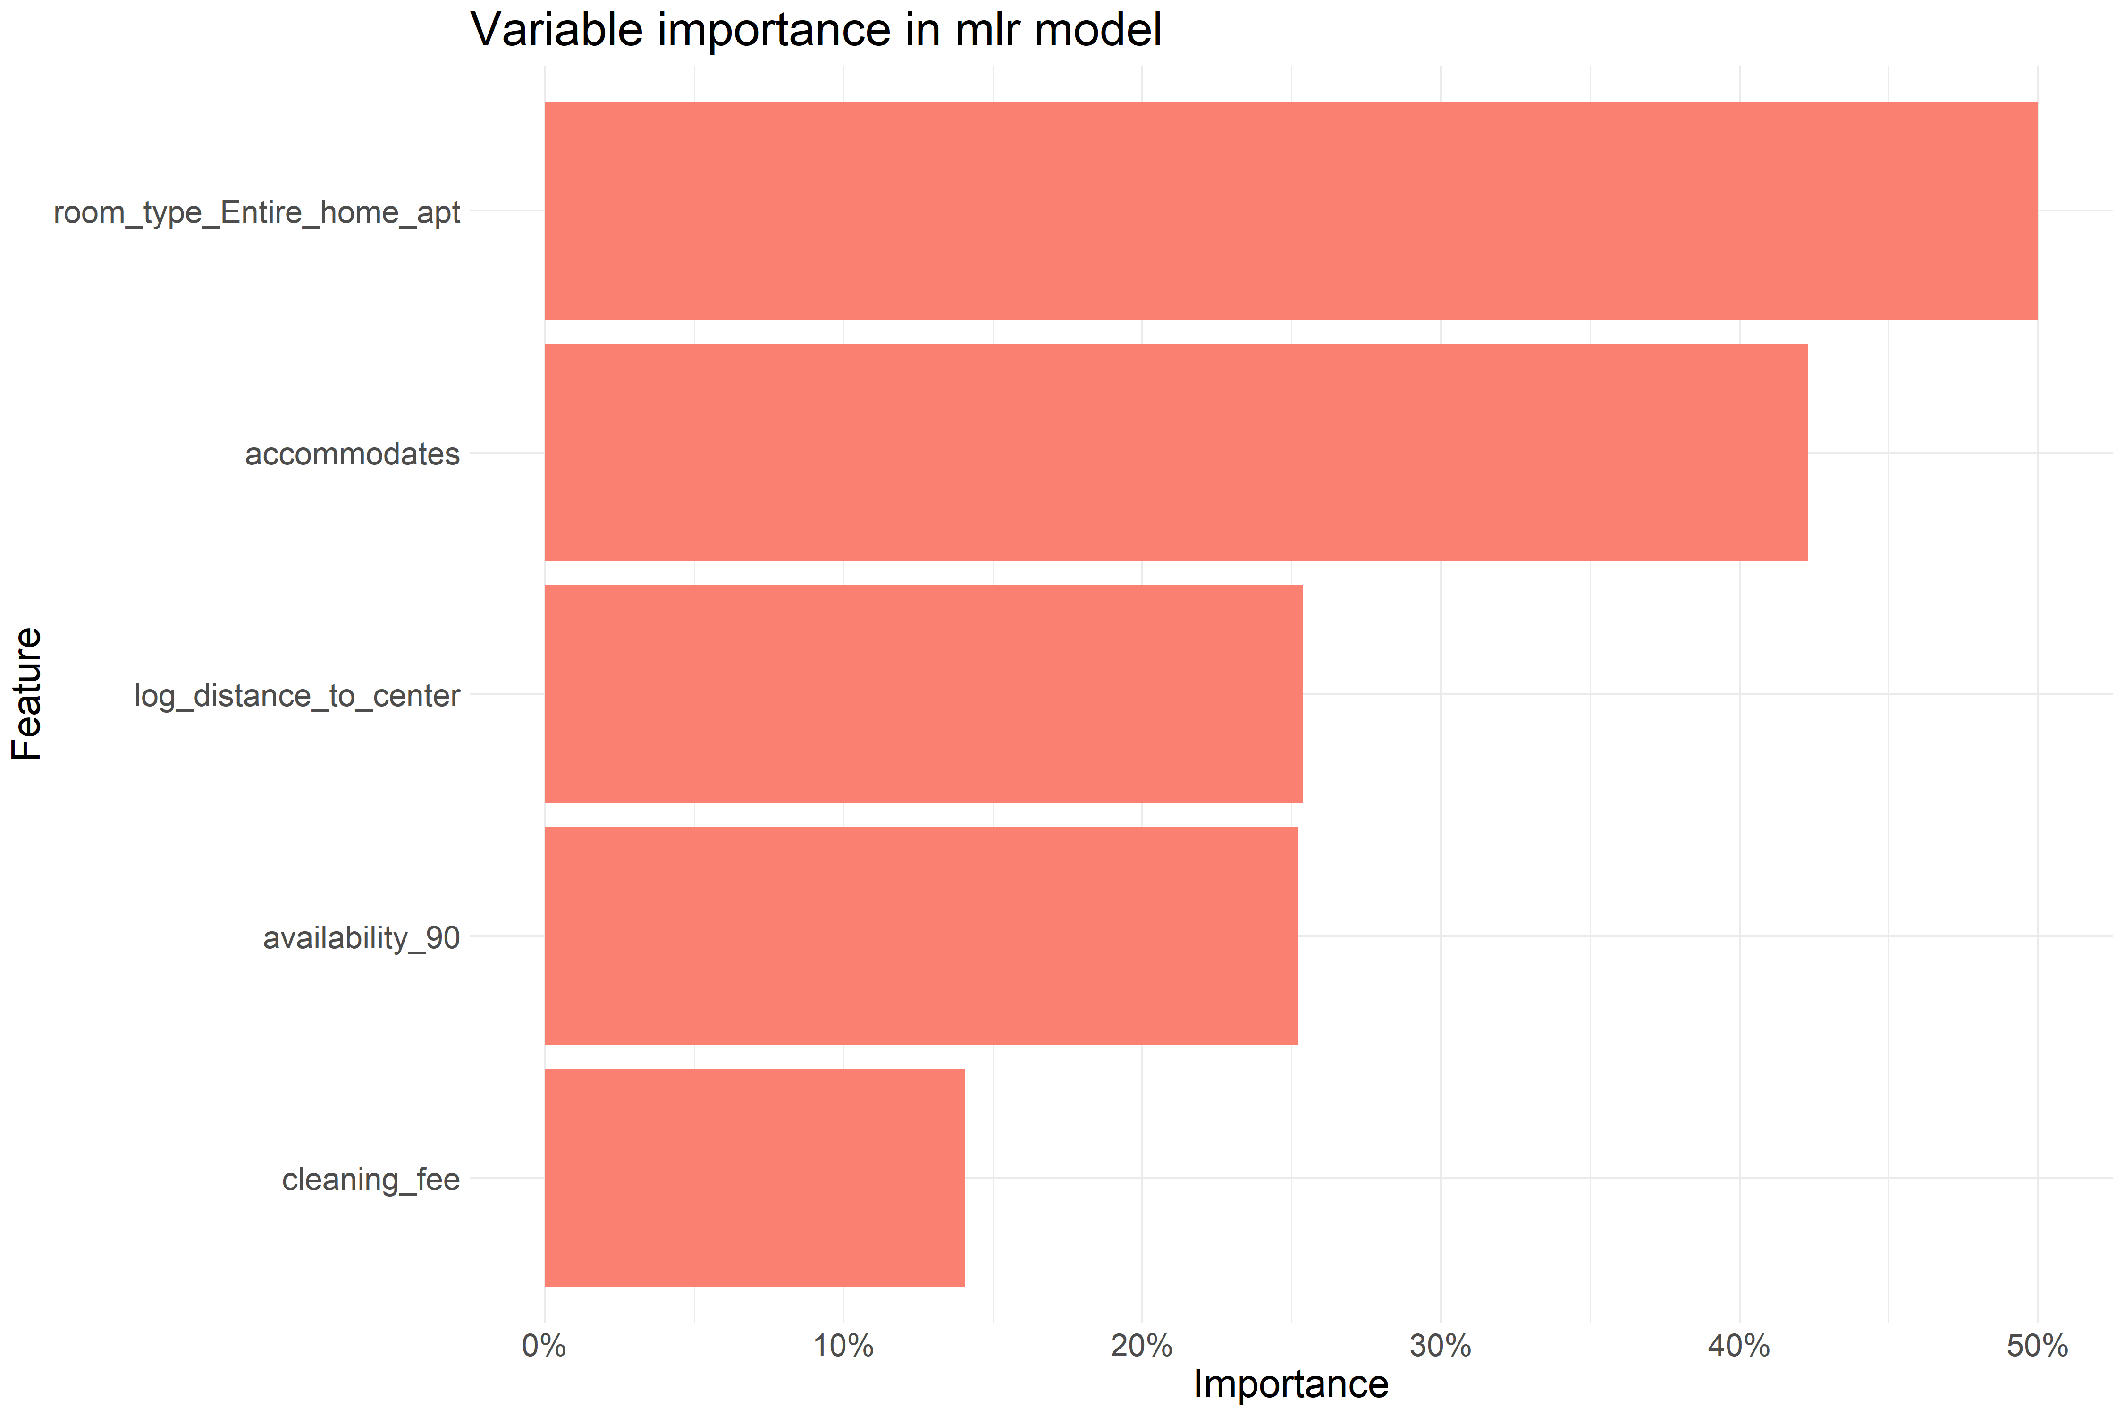
Step 5 – Regression modeling

Slide 12
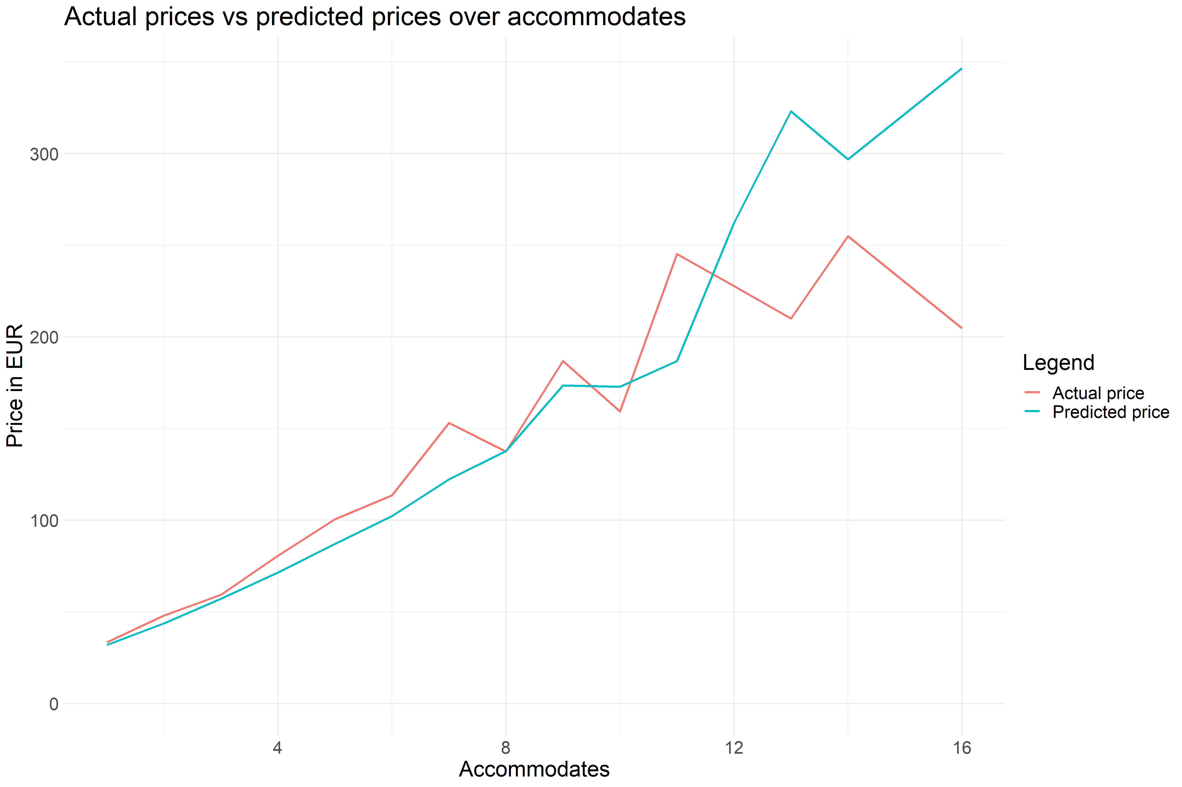
Step 5 – Regression modeling

Slide 13
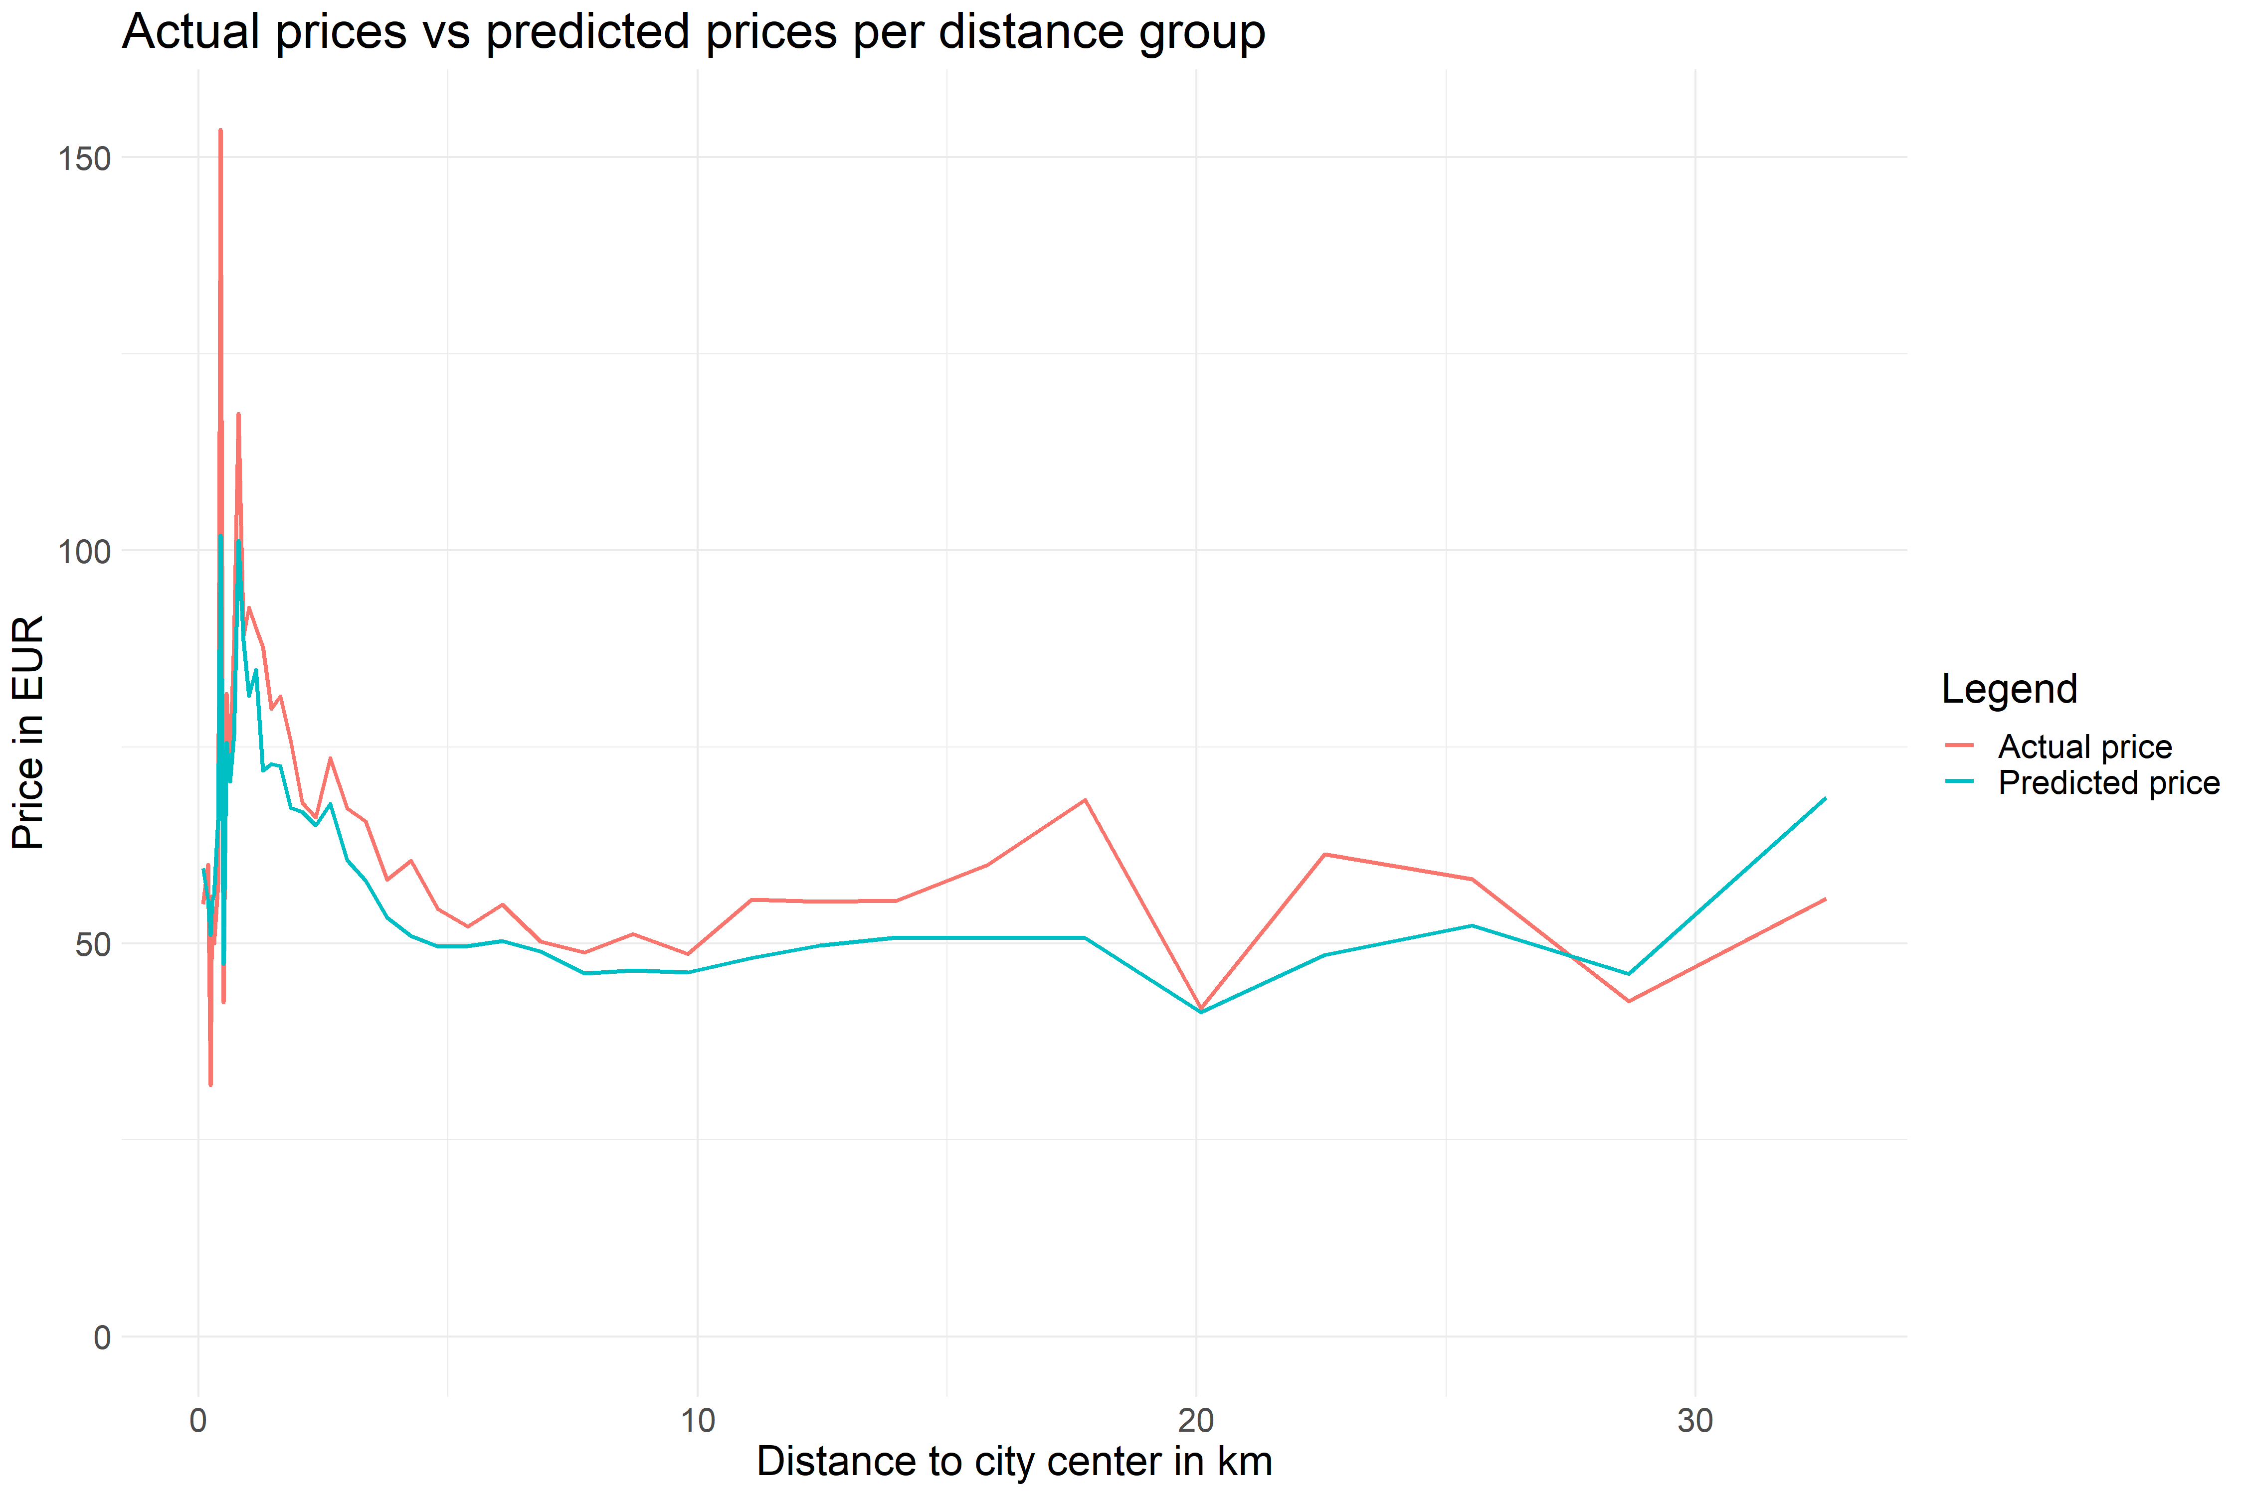
Step 5 – Regression modeling

Slide 14
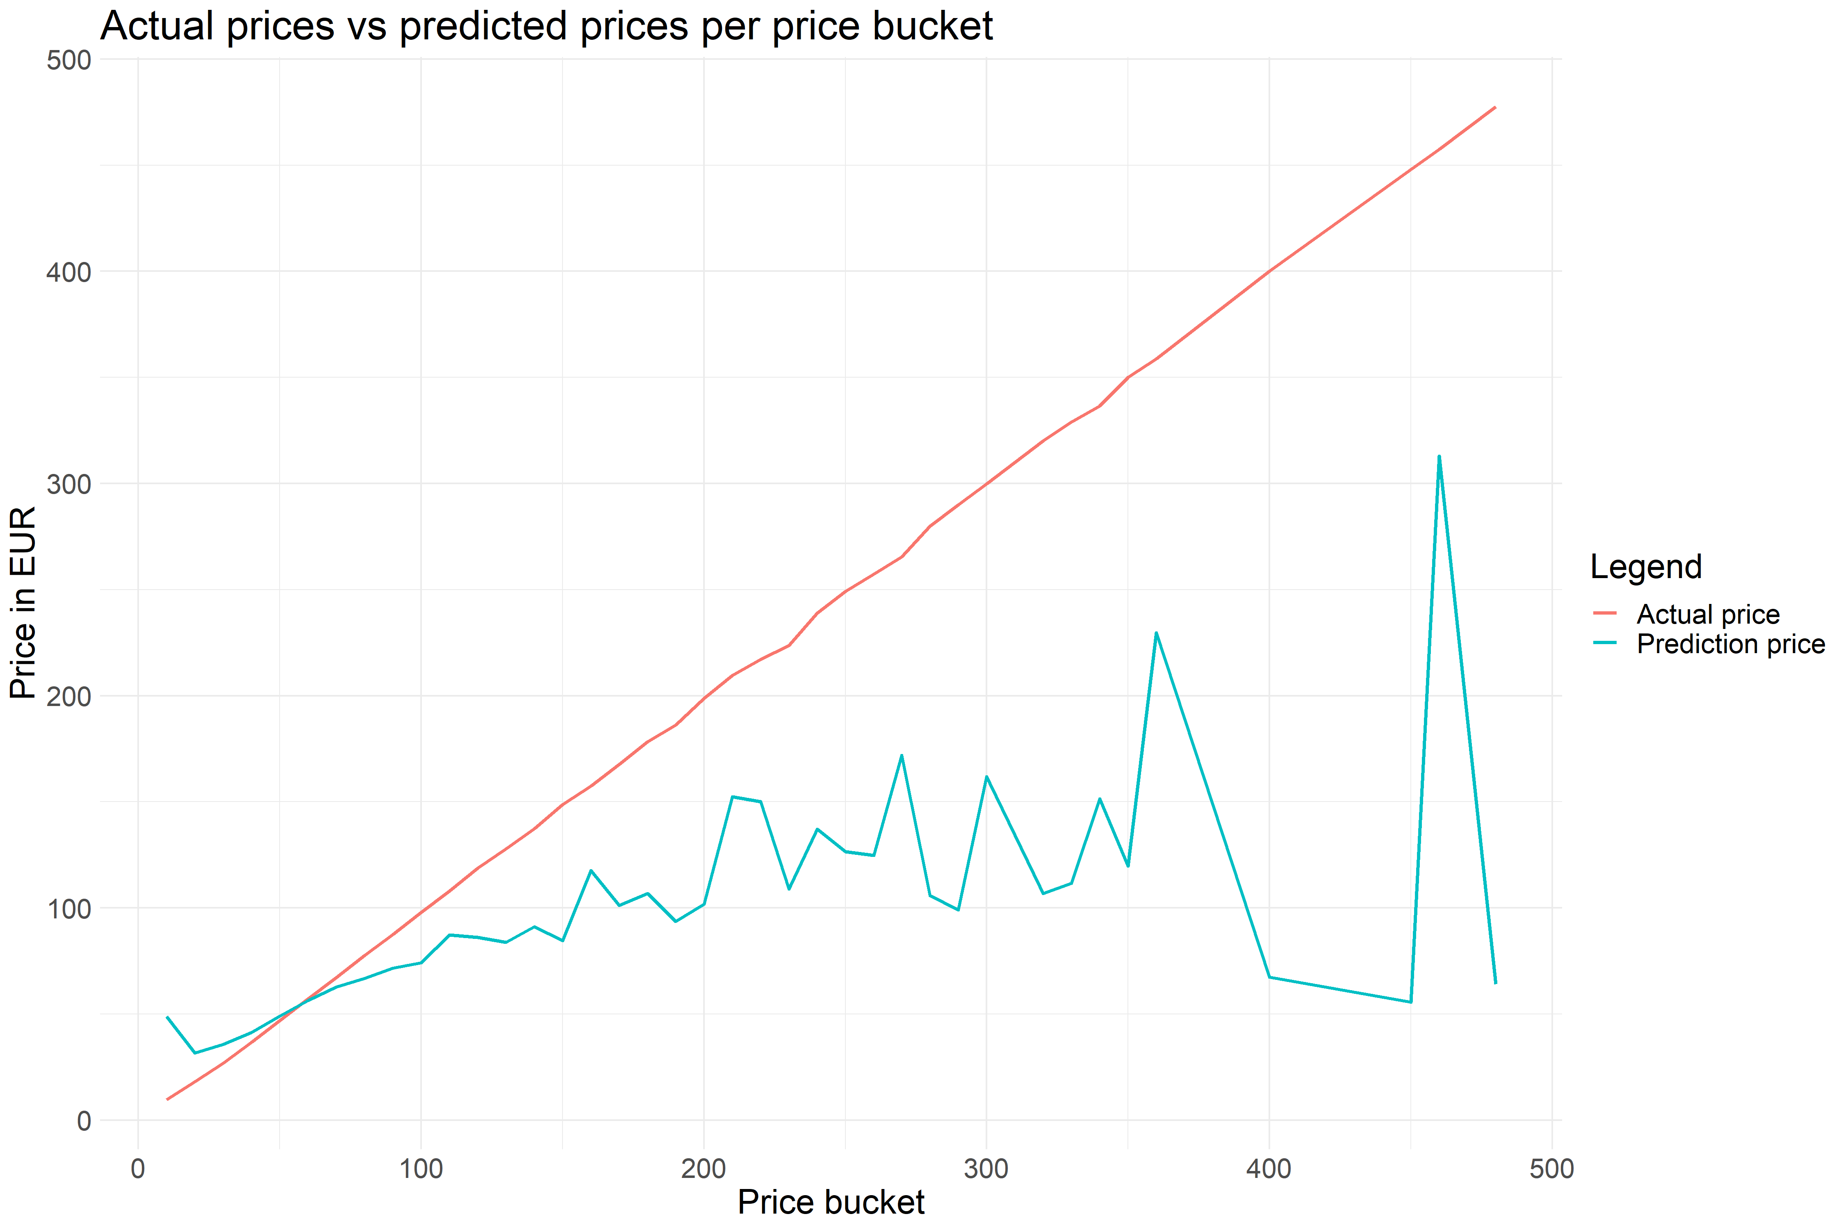
Step 5 – Regression modeling

Slide 15
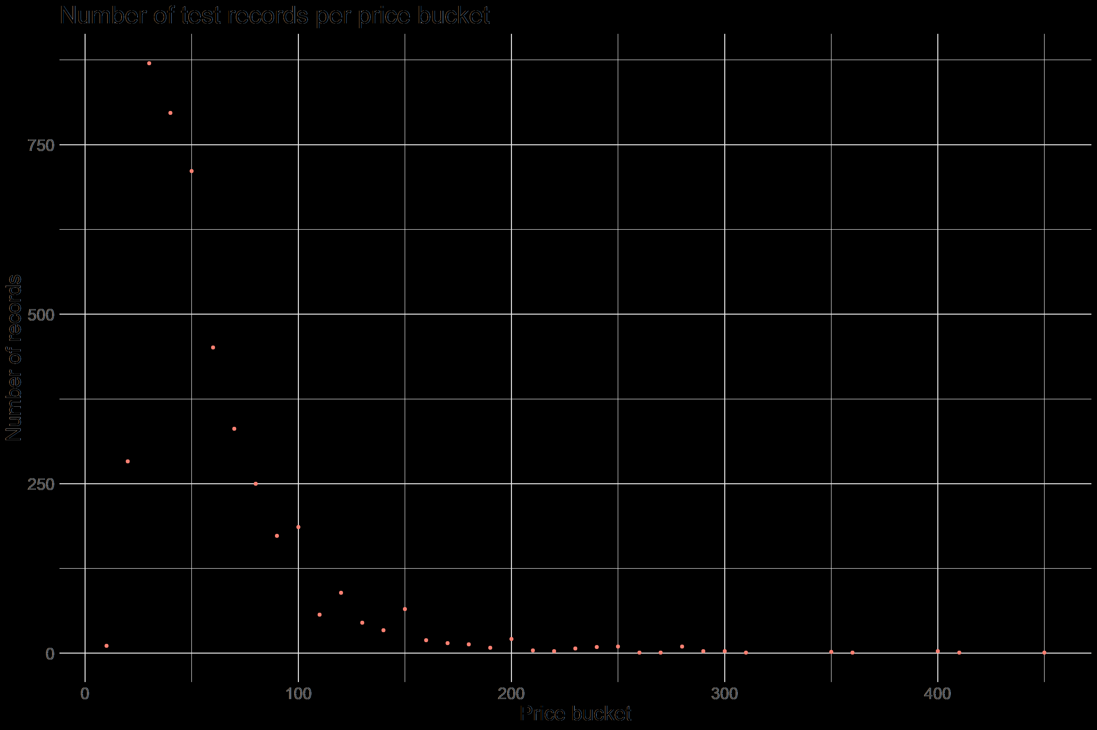
Step 5 – Regression modeling

Slide 16
Step 5 – Regression modeling
Now we have a benchmark for a more complex model to improve on, R² = 42%
First some details on how XGBoost works:
XGBoost is an iterative process that tries to improve on itself with the following flow
XGBoost builds a model for an initial guess on the price for each listing
XGBoost then considers the error made by this model and builds a new model to negate those errors
The values of the second model are added to the first with a scaling factor
This process is repeated until the model no longer improves or a limit has been reached
This allows XGBoost to use many, many more coefficients to find the best model¹

Slide 17
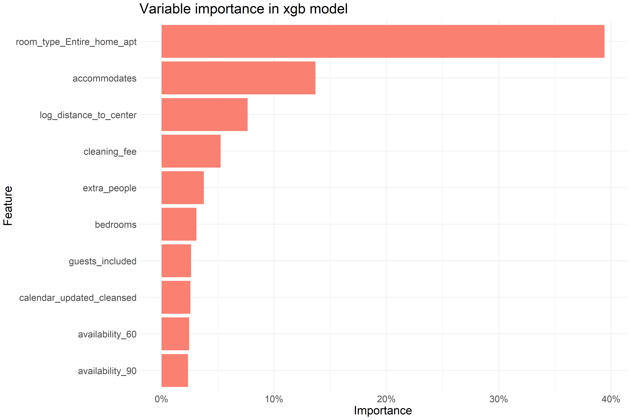
Step 6 – Model assessment
Column | Value | Benchmark
R² | 62.7% | 42.1%
MAE | 15.2EUR | 18.4EUR
RMSE | 25.5EUR | 33.7EUR

Slide 18
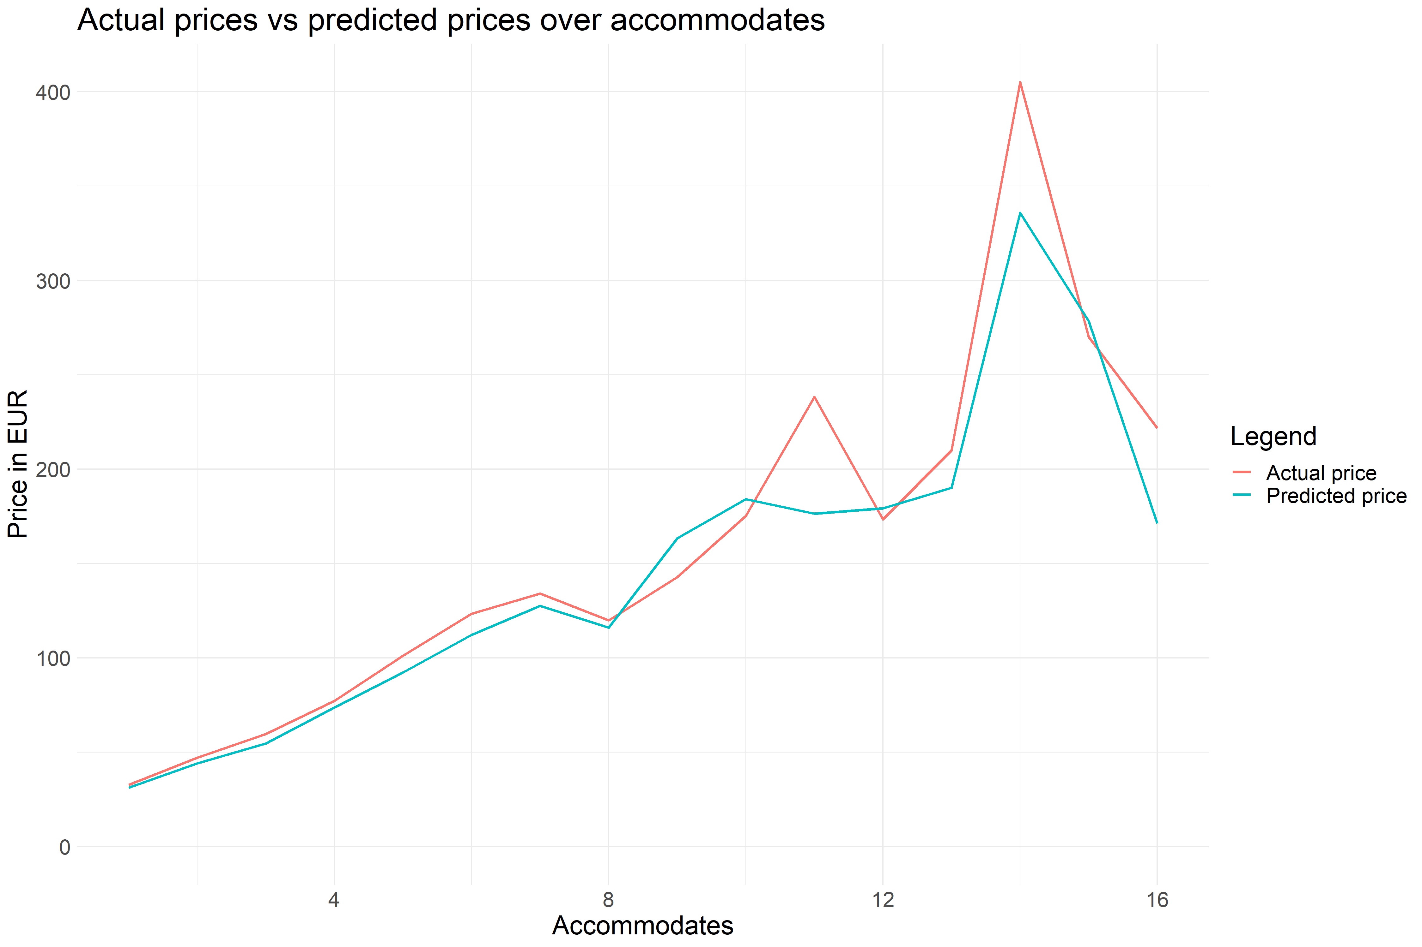
Step 6 – Model assessment

Slide 19
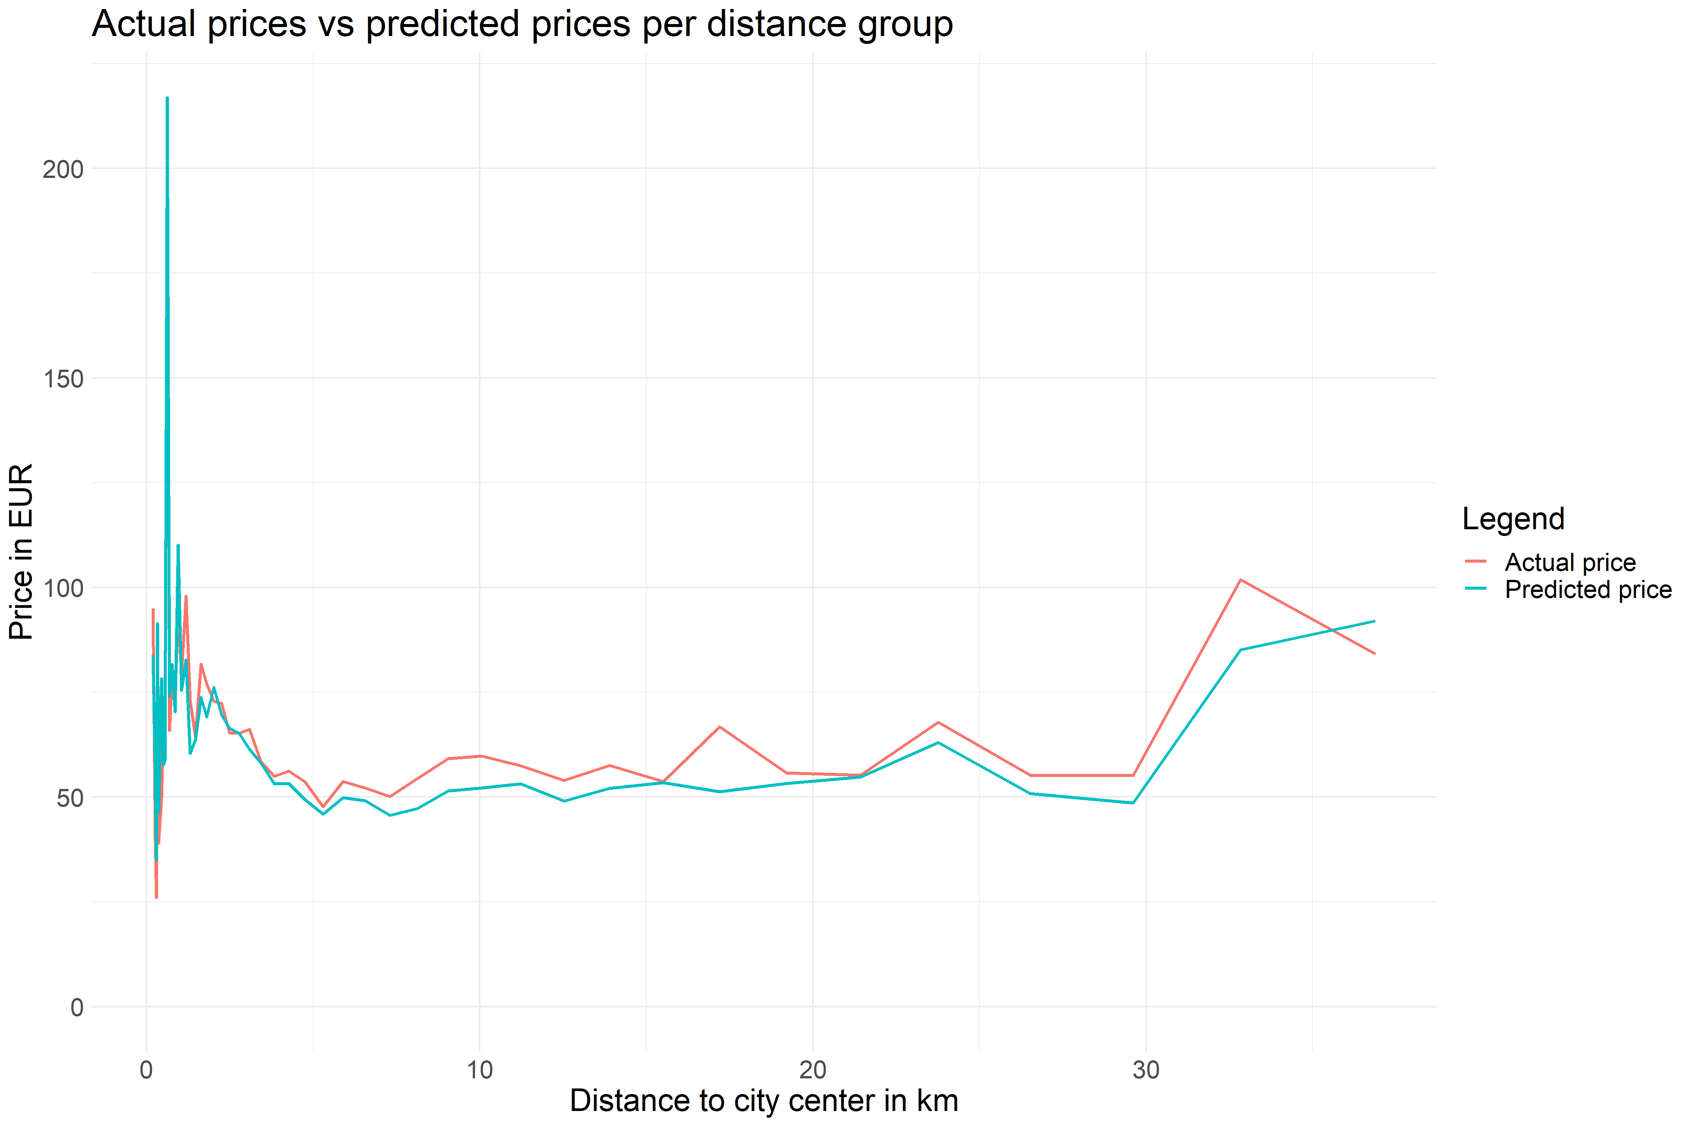
Step 6 – Model assessment

Slide 20
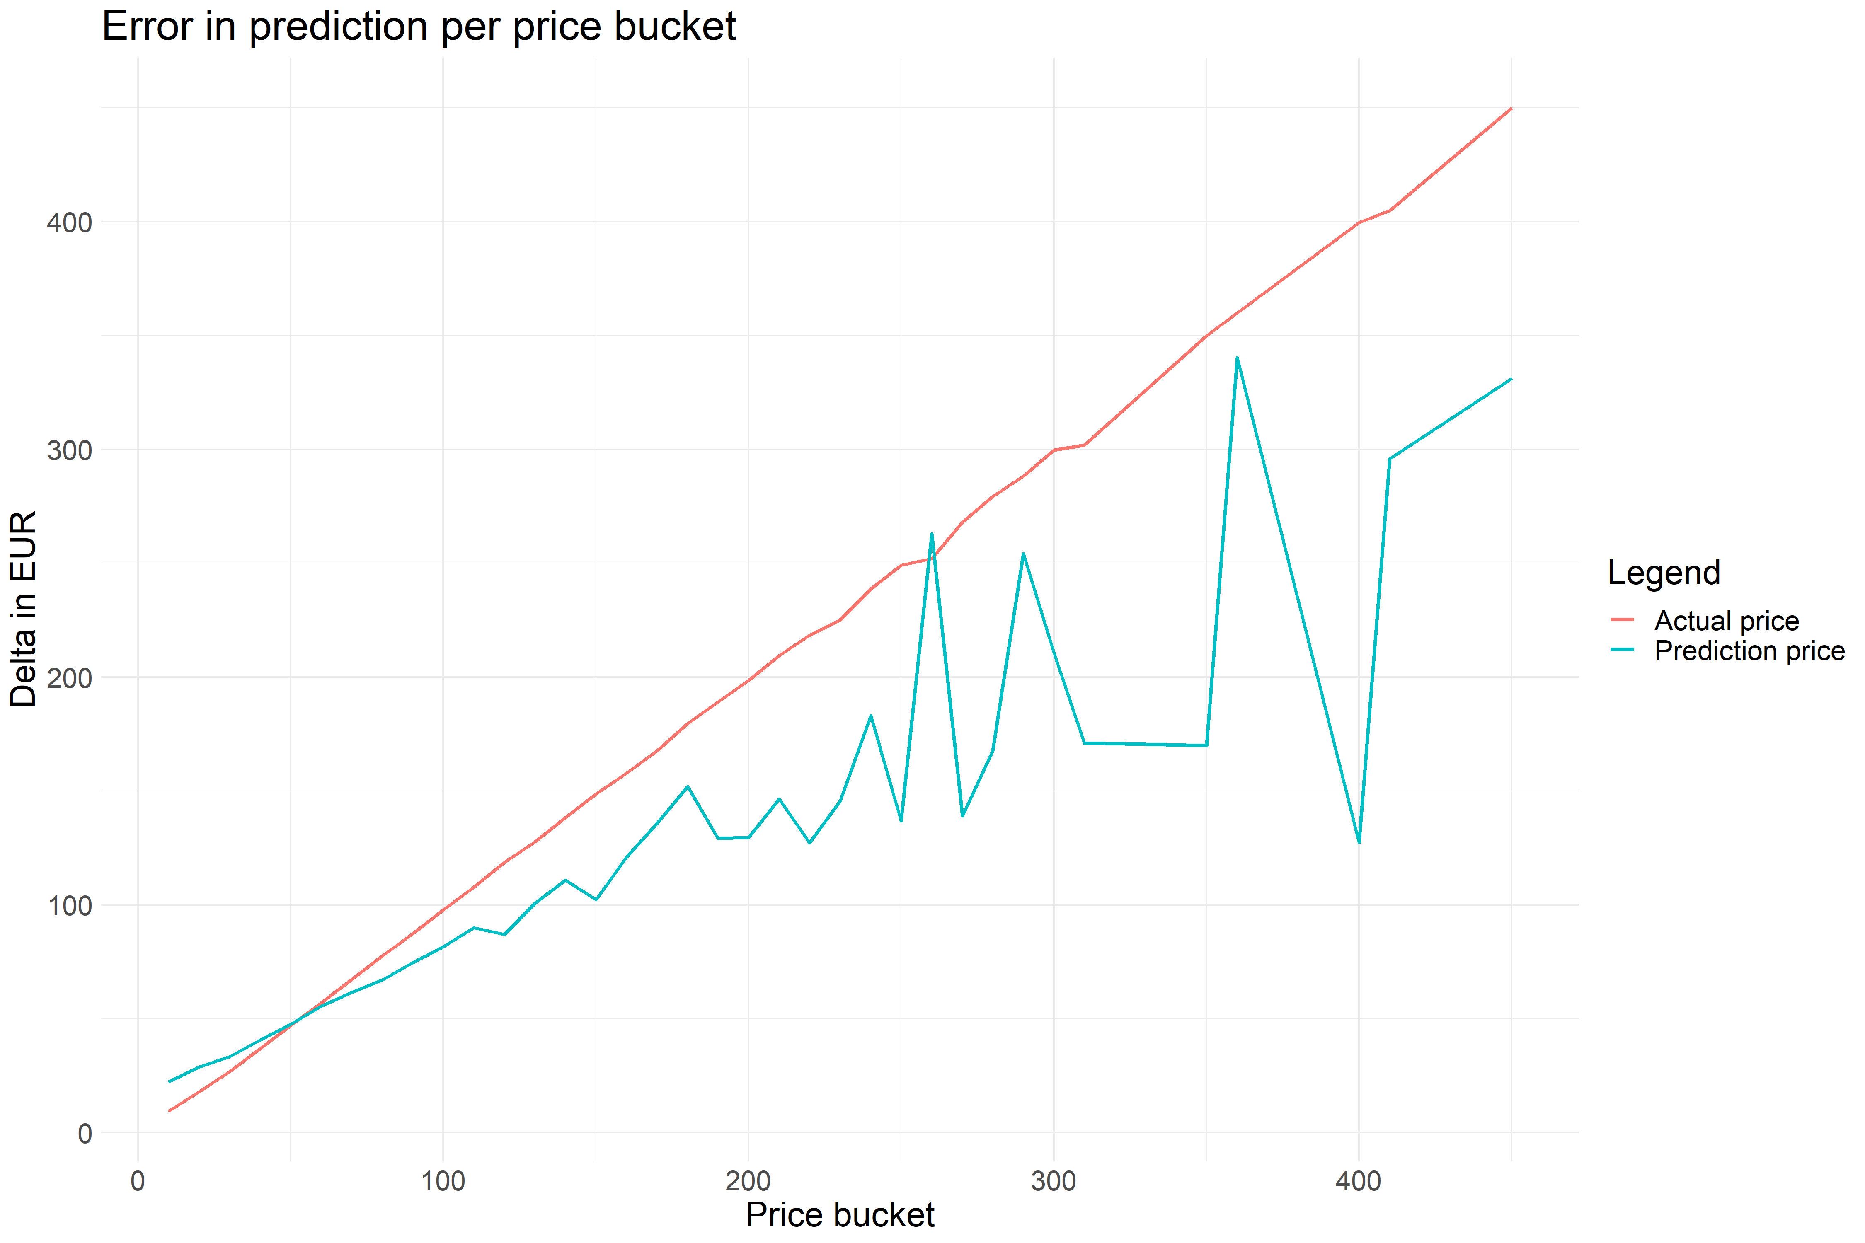
Step 6 – Model assessment

Slide 21
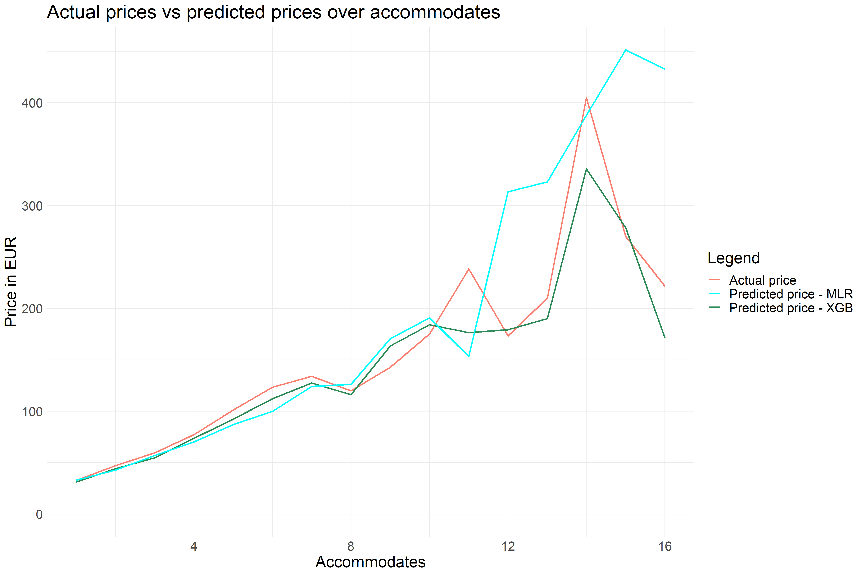
Step 6 – Model assessment

Slide 22
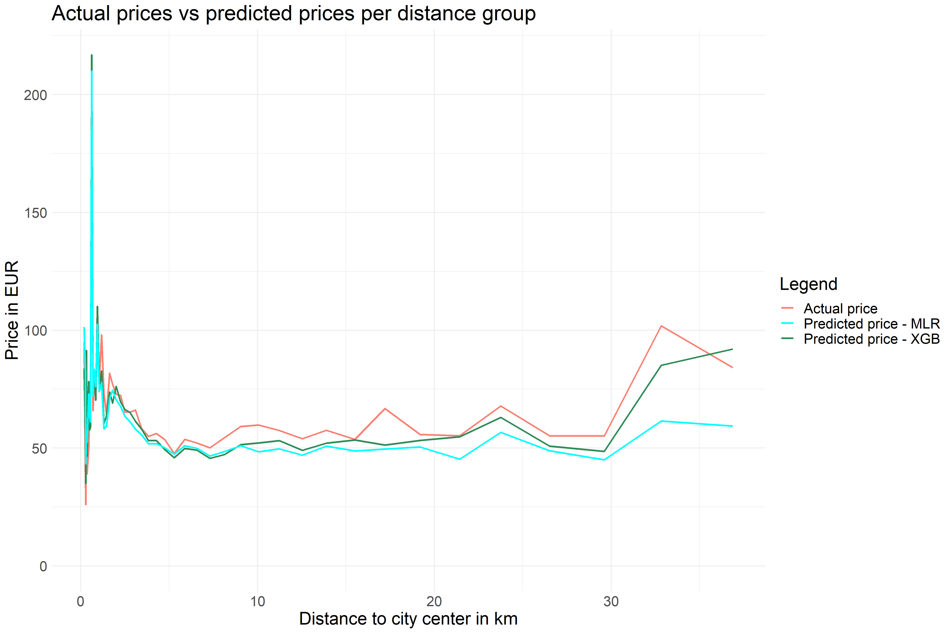
Step 6 – Model assessment

Slide 23
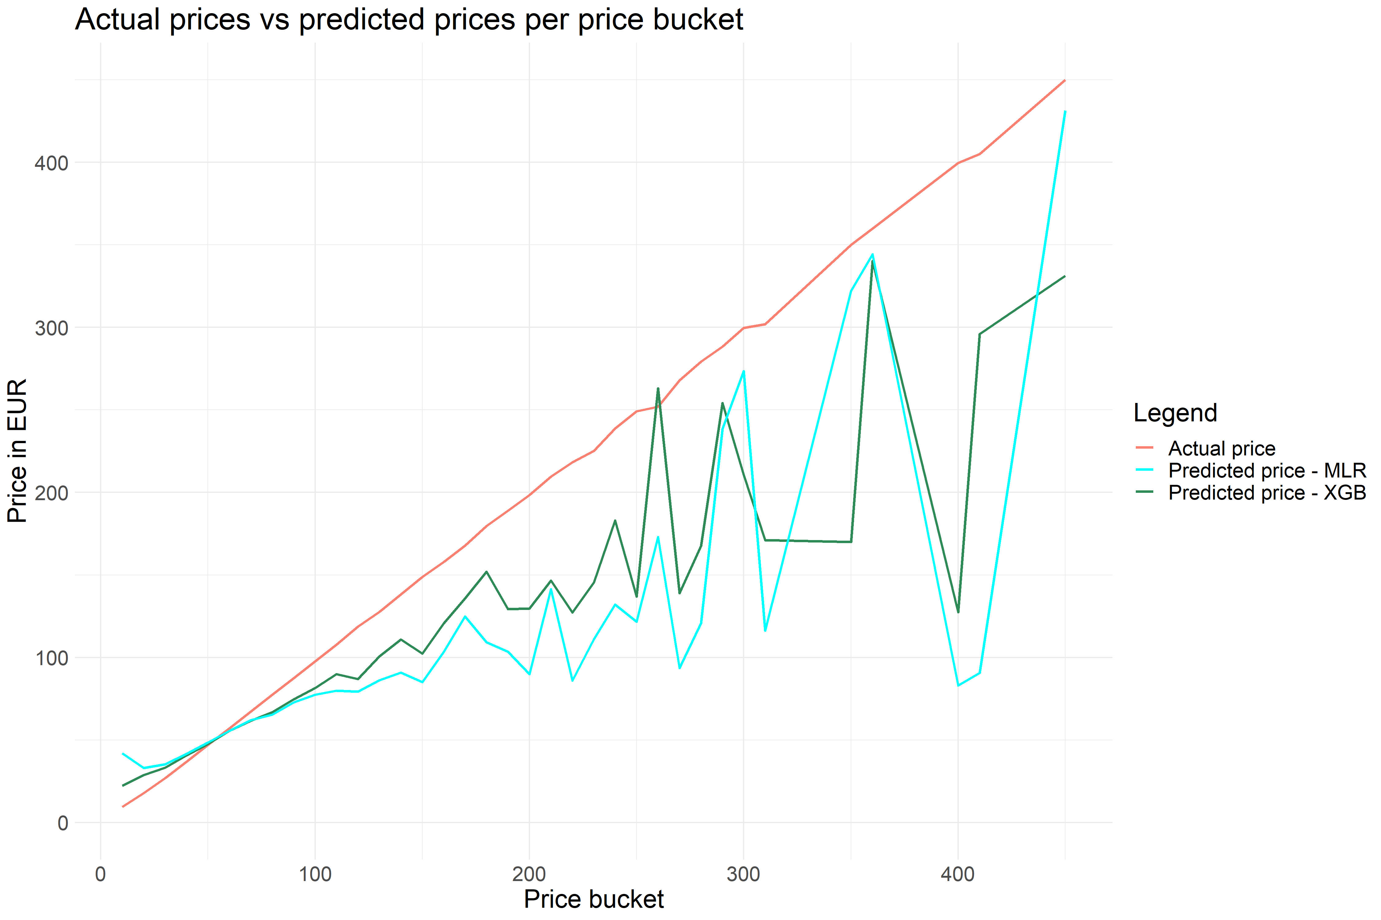
Step 6 – Model assessment

Slide 24
Step 6 – Regression modeling
Final notes
XGBoost produces far better results across the spectrum
The complexity of XGBoost may be a downside to some
This model tries to predict what a lister values his property, not what a tenant values that property
Personal information may be highly relevant to the choice of price
The moment of pricing may also be relevant (in-season vs off-season)
A use case could be for either Airbnb themselves to provide a recommendation price, or as a governing tool to prohibit excessive prices

Slide 25
Appendix
Airbnb listing price model

Slide 26
Appendix - Step 2 – Column class distribution
96 columns - Dependent variable Price¹
Data type | Character | Categorical | Logical | Integer | Numerical | Date
# of columns | 20 | 14 | 10 | 22 | 10 | 4
Example column | description | bed_type | host_is_superhost | beds | price | first_review
Example value | “lovely apartment in...” | Pull-out sofa | t, f | 0,1,2,...,20 | 69.99 | ‘2015-01-01’

Slide 27
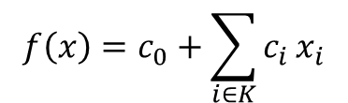
Appendix - Step 6 – MLR details
$$f\left(x\right)=c_{0}+\sum_{i∈K}{c_{i}}x_{i}$$
where K is the collection of viable variables. The while loop eliminates the worst variable from K

Slide 28
Appendix - Step 6 – XGBoost details
<5km to City Center
Y
N
+ 0.3
Is an apartment
Accommodates >5
Cleaning fee >20
Y
N
>10km to City Center
More than 40 days available next 90 days
Y
N
Y
N
Y
N
Y
N
Price: +5
Price: -10
Price: -3
Price: +5
Price: 100
Price: 70
Price: 60
Price: 40
+ 0.3

